Slide 1

CIT228 Final Project
Emily Richardson
Michigan Running community

Slide 2
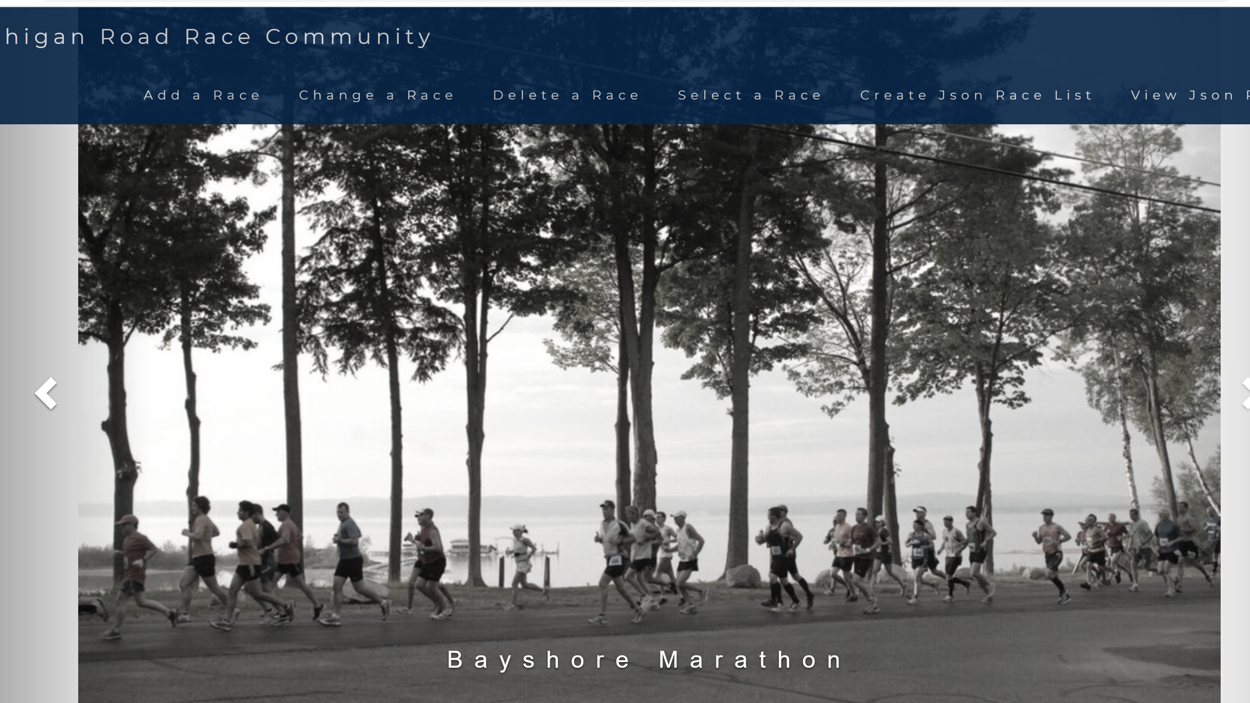
Audience
All ages
Individuals interested in running
Race directors
Mainly Michigan residents
Other state residents

Slide 3
Table Overciew
CREATE TABLE master_raceName ( id INT NOT NULL PRIMARY KEY AUTO_INCREMENT, date_added DATETIME,
date_modified DATETIME,
race_name VARCHAR (75), );
CREATE TABLE raceLocation ( id INT NOT NULL PRIMARY KEY AUTO_INCREMENT, master_id INT NOT NULL, date_added DATETIME, date_modified DATETIME, city VARCHAR (30), state CHAR (2), zipcode VARCHAR (10), type ENUM ('marathon', 'half marathon', '10k', '5k',) );
CREATE TABLE date ( id INT NOT NULL PRIMARY KEY AUTO_INCREMENT, master_id INT NOT NULL,
date_added DATETIME,
date_modified DATETIME,
month VARCHAR (30), day CHAR (2), year VARCHAR (4), );
CREATE TABLE email ( id INT NOT NULL PRIMARY KEY AUTO_INCREMENT, master_id INT NOT NULL,
date_added DATETIME,
date_modified DATETIME,
email VARCHAR (150), );
CREATE TABLE race _notes ( id int NOT NULL PRIMARY KEY AUTO_INCREMENT, master_id INT NOT NULL UNIQUE,
date_added DATETIME,
date_modified DATETIME, note TEXT );

Slide 4
CSS Layout
Layout from W3 Schools
BS Theme “band”
Carousel

Slide 5
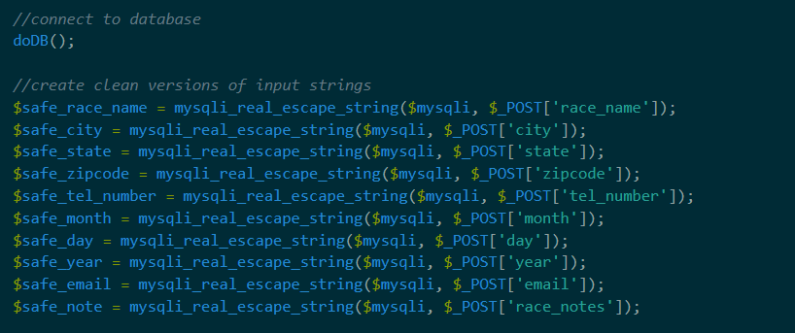
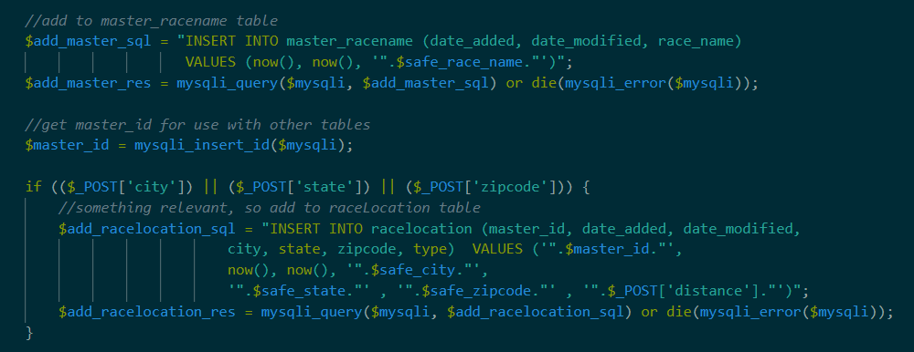
Add a Race

Slide 6
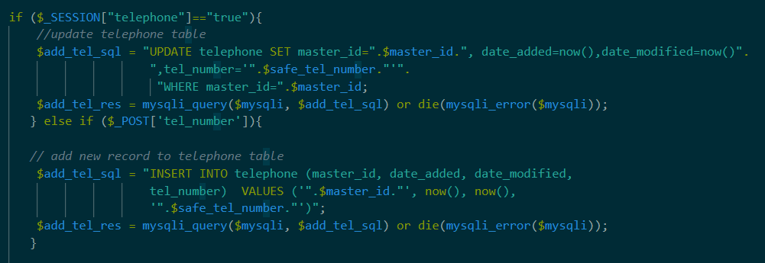
Change a race

Slide 7
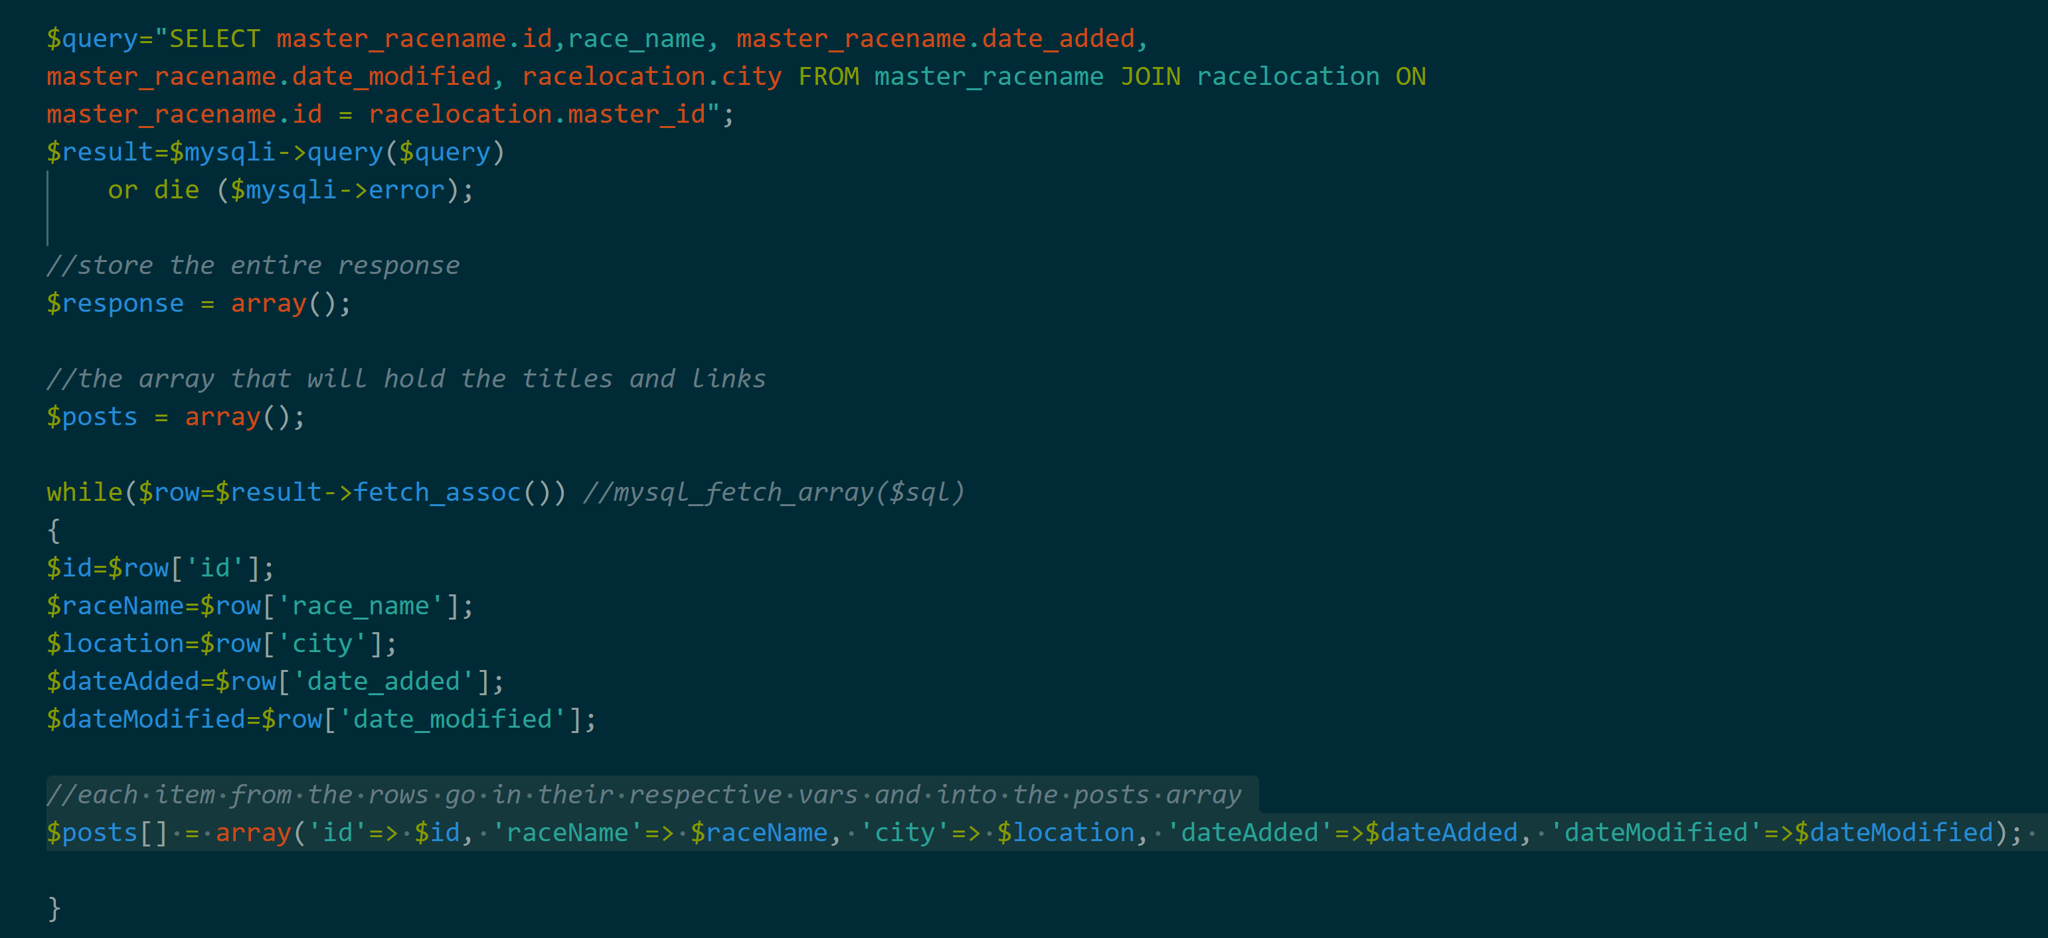
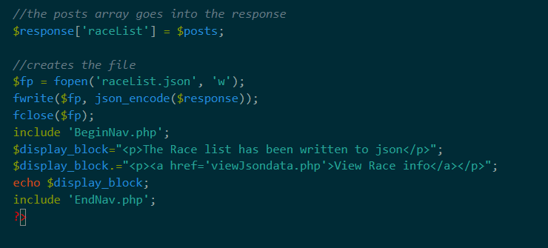
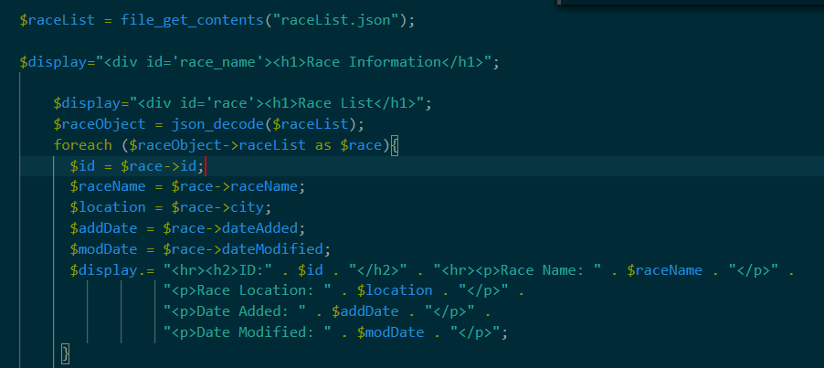
View Races

Slide 8
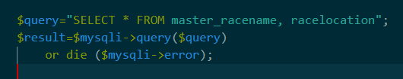
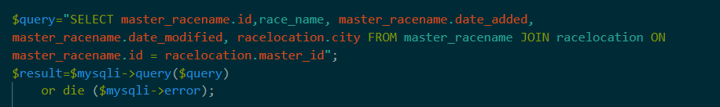
Problems
Select statement in readSQLwriteJson.php
Retrieving data from two tables. Master Race ID and the Race Name
Date modified column in both.
Prefixes with the table name.

Slide 9
Questions?

